Slide 1
Superscalar Processors
Notes:
Please if anyone has additional comments please speak up

Slide 2
Recall from Pipelining
Pipeline CPI = Ideal pipeline CPI + Structural Stalls + Data Hazard Stalls + Control Stalls
  Ideal pipeline CPI: measure of the maximum performance attainable by the implementation
  Structural hazards: HW cannot support this combination of instructions
  Data hazards: Instruction depends on result of prior instruction still in the pipeline
  Control hazards: Caused by delay between the fetching of instructions and decisions about changes in control flow (branches and jumps)

Slide 3
Techniques to Reduce Stalls and Increase ILP
Hardware Schemes to Reduce:
  Structural hazards
    Memory: Separate instruction and data memory
    Registers: Write 1st half of cycle and read 2nd half of cycle
Mem
Mem
Reg
Reg
ALU

Slide 4
Techniques to Reduce Stalls and Increase ILP
Hardware Schemes to Reduce:
  Data Hazards
    Forwarding
Zero?
MUX MUX
D/A Buffer
A/M Buffer
M/W Buffer
ALU
Data
Memory

Slide 5
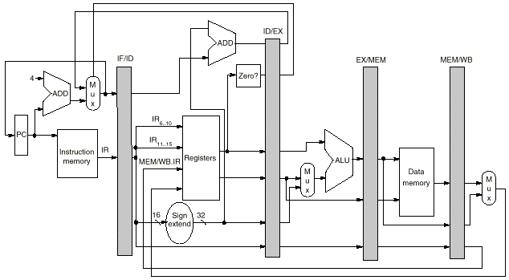
Techniques to Reduce Stalls and Increase ILP
Hardware Schemes to Reduce:
  Control Hazards
    Moving the calculation of the target branch earlier in the pipeline

Slide 6
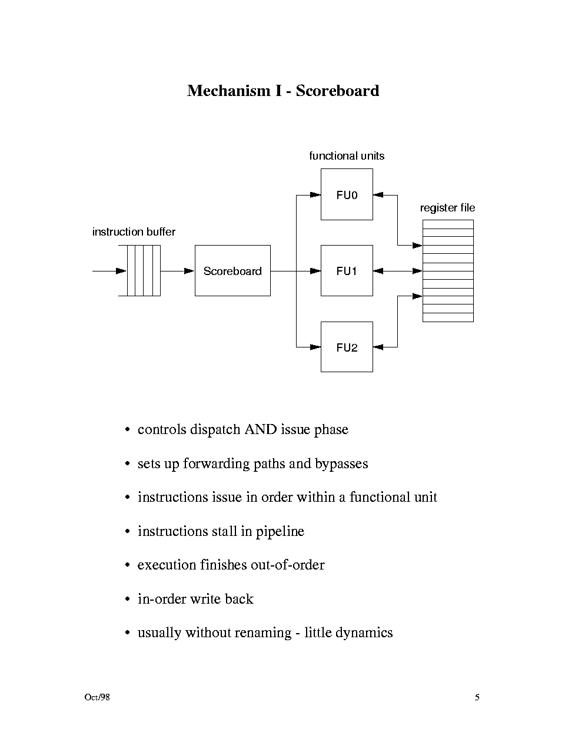
Techniques to Reduce Stalls and Increase ILP
Hardware Schemes to increase ILP:
  Scoreboarding
    Allows out-of-order execution of instructions

Slide 7
Techniques to Reduce Stalls and Increase ILP
Hardware Schemes to increase ILP:
  Scoreboarding
    Allows out-of-order execution of instructions
Instruction status
Read
Execution
Write
Instruction
j
k
Issue
operands
complete
Result
L.D
F6
34+
R2
1
2
3
4
L.D
F2
45+
R3
5
6
7
8
MUL.D
F0
F2
F4
6
9
19
20
SUB.D
F8
F6
F2
7
9
11
12
DIV.D
F10
F0
F6
8
21
61
62
ADD.D
F6
F8
F2
13
14
16
22
We have:
  In-oder issue,
  Out-of-order execute and commit

Slide 8
Techniques to Reduce Stalls and Increase ILP
Hardware Schemes to Reduce:
  Data Hazards
    Similar to scoreboarding but more advanced (e.g., register renaming)
  Control Hazards
    Dynamic branch prediction (using buffer lookup schemes)

Slide 9
Techniques to Reduce Stalls and Increase ILP
Software Schemes to Reduce:
  Data Hazards
    Compiler Scheduling: reduce load stalls
Original code with stalls:
LD Rb,b
LD Rc,c
DADD Ra,Rb,Rc
SD Ra,a
LD Re,e
LD Rf,f
DSUB Rd,Re,Rf
SD Rd,d
Scheduled code with no stalls:
LD Rb,b
LD Rc,c
LD Re,e
DADD Ra,Rb,Rc
LD Rf,f
SD Ra,a
DSUB Rd,Re,Rf
SD Rd,d
Stall
Stall

Slide 10
Techniques to Reduce Stalls and Increase ILP
Software Schemes to Reduce:
  Data Hazards
    Compiler Scheduling: register renaming to eliminate WAW and WAR hazards

Slide 11
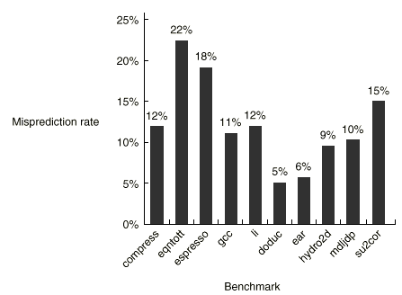
Techniques to Reduce Stalls and Increase ILP
Software Schemes to Reduce:
  Control Hazards
    Branch prediction
      Example : choosing backward branches (loop) as taken and forward branches (if) as not taken
      Tracing Program behaviour

Slide 12
Techniques to Reduce Stalls and Increase ILP
Software Schemes to Reduce:
  Control Hazards
    Loop unrolling
4n iterations
n iterations
4 iterations
4 iterations

Slide 13
Techniques to Reduce Stalls and Increase ILP
Software Schemes to Reduce:
  Control Hazards
    Increase loop parallelism
for (i=1; i<=100; i=i+1) {
A[i] = A[i] + B[i]; /* S1 */
B[i+1] = C[i] + D[i]; /* S2 */
}
  Can be made parallel by replacing the code with the following:
  A[1] = A[1] + B[1];
  for (i=1; i<=99; i=i+1) {
  B[i+1] = C[i] + D[i];
  A[i+1] = A[i+1] + B[i+1];
  }
  B[101] = C[100] + D[100];

Slide 14
Using these Hardware and Software Techniques
Pipeline CPI = Ideal pipeline CPI + Structural Stalls + Data Hazard Stalls + Control Stalls
  All we can achieve is to be close to the ideal CPI =1
  In practice CPI is around 0.9
This is because we can only issue one instruction per clock cycle to the pipeline
How can we do better ?

Slide 15
A Model of an Ideal Processor
  No structural hazards
  Register renaming—infinite registers and all WAW & WAR hazards avoided
  Processor with perfect prediction
    Branch prediction—perfect; no mispredictions
    Jump prediction—all jumps perfectly predicted
There are only true data dependences left!
I: add r1,r2,r3
J: sub r4,r1,r3

Slide 16
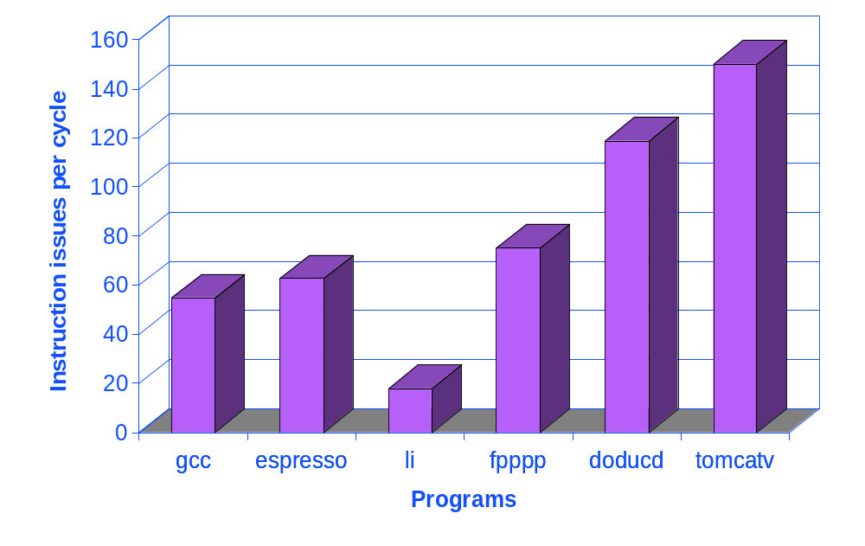
Upper Bound on ILP
FP: 75 - 150
Integer: 18 - 60

Slide 17
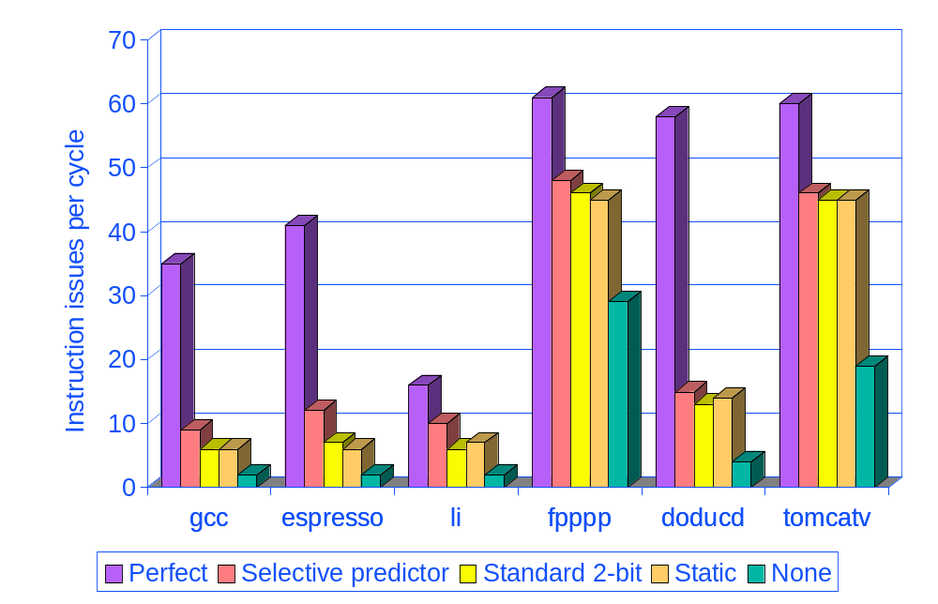
More Realistic: Branch Impact
Window: 2000 instructions
Max 64 instr/cycle issue

Slide 18
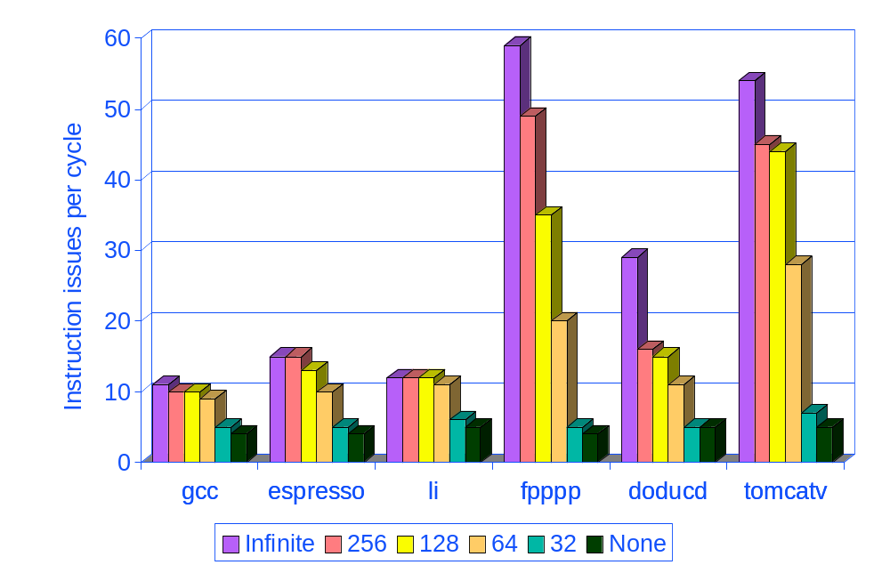
Renaming Register impact
Window: 2000 instructions
Max 64 instr/cycle issue

Slide 19
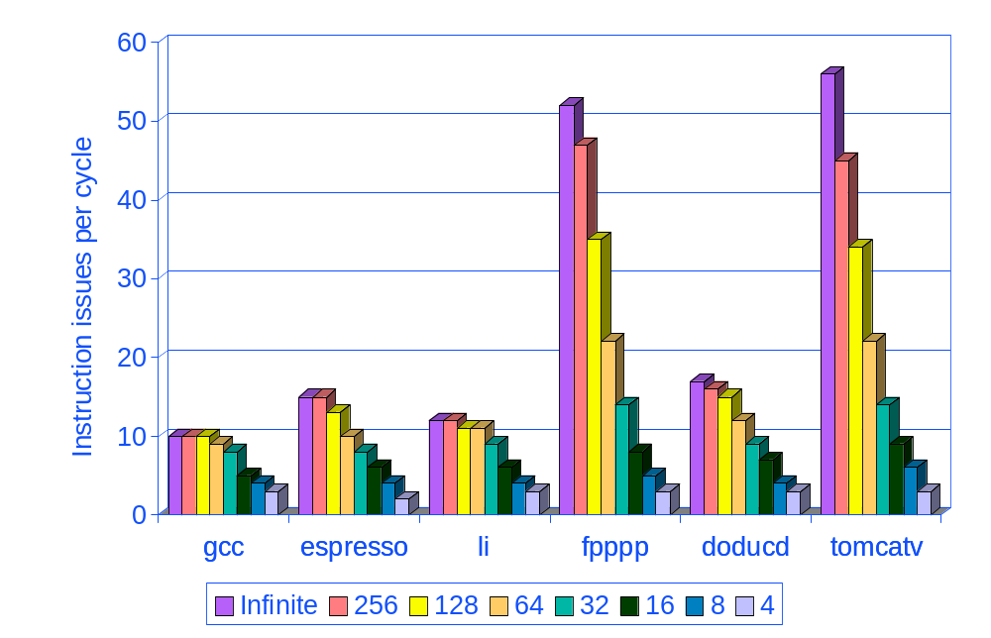
Window Impact
Window: 200 instructions
Max 64 instr/cycle issue

Slide 20
How do we take advantage of this large number of ILP
Superscalar processors
VLIW (Very Long Instruction Word) processors
All high-performance modern processors (e.g., Pentium, Sparc, Itanium) use one of the above techniques.

Slide 21
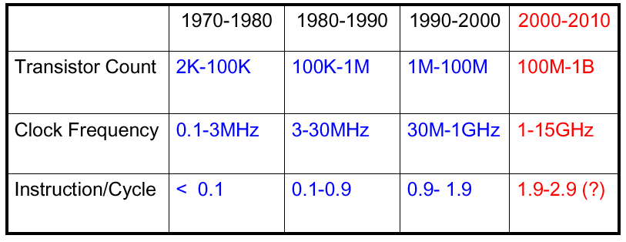
Evolution of Processor Performance
Multi-cycle
Pipelined
(single issue)
Multiple Issue (CPI <1)
Superscalar/VLIW
CPI > 10 1.1-10 0.5 - 1.1 .35 - .5 (?)

Slide 22
Multiple Instruction Issue: CPI < 1
To improve a pipeline’s CPI to be better [less] than one, and to utilize ILP better, a number of independent instructions have to be issued in the same pipeline cycle.
Anticipated success of multiple instructions lead to
Instructions Per Clock cycle (IPC) vs. CPI
Multiple instruction issue processors are of two types:
  Superscalar: A number of instructions (2-8) is issued in the same cycle, scheduled statically by the compiler or dynamically (scoreboarding, Tomasulo).
    Pentium, PowerPC, Sun UltraSparc, Alpha, HP 8000 ...

Slide 23
Multiple Instruction Issue: CPI < 1
  VLIW (Very Long Instruction Word):
  A fixed number of instructions (3-16) are formatted as one long instruction word or packet (statically scheduled by the compiler).
      Joint HP/Intel (Itanium).
      Intel Architecture-64 (IA-64) 64-bit processor:
        Explicitly Parallel Instruction Computer (EPIC): Itanium.
Limitations of the approaches:
  Available ILP in the program (both).
  Specific hardware implementation difficulties (superscalar).
  VLIW optimal compiler design issues.

Slide 24
Simple Statically Scheduled Superscalar Pipeline
Two instructions can be issued per cycle (two-issue superscalar).
One of the instructions is integer (including load/store, branch). The other instruction is a floating-point operation.
  This restriction reduces the complexity of hazard checking.
  Fetch 64-bits/clock cycle; Int on left, FP on right
  – Can only issue 2nd instruction if 1st instruction issues
Hardware must fetch and decode two instructions per cycle.
Then it determines whether zero (a stall), one or two instructions can be issued per cycle.

Slide 25
Simple Statically Scheduled Superscalar Pipeline
Instruction Type
1 2 3 4 5 6 7 8
Integer Instruction
IF
IF
ID
ID
IF
IF
EX
EX
ID
ID
IF
IF
MEM
EX
EX
EX
ID
ID
IF
IF
WB
EX
MEM
EX
EX
EX
ID
ID
WB
WB
EX
MEM
EX
EX
EX
WB
WB
EX
MEM
EX
WB
WB
EX
FP Instruction
Integer Instruction
FP Instruction
Integer Instruction
FP Instruction
Integer Instruction
FP Instruction
2-Issue pipeline (Integer & FP)

Slide 26
Unrolled Loop that Minimizes Stalls for Scalar
1 Loop: LD F0,0(R1)
2 LD F6,-8(R1)
3 LD F10,-16(R1)
4 LD F14,-24(R1)
5 ADDD F4,F0,F2
6 ADDD F8,F6,F2
7 ADDD F12,F10,F2
8 ADDD F16,F14,F2
9 SD 0(R1),F4
10 SD -8(R1),F8
11 SD -16(R1),F12
12 SUBI R1,R1,#32
13 BNEZ R1,LOOP
14 SD 8(R1),F16 ; 8-32 = -24
14 clock cycles, or 3.5 per iteration
LD to ADDD: 1 Cycle
ADDD to SD: 2 Cycles

Slide 27
Loop Unrolling in Superscalar
Integer instruction FP instruction Clock cycle
Loop: LD F0,0(R1) 1
LD F6,-8(R1) 2
LD F10,-16(R1) ADDD F4,F0,F2 3
LD F14,-24(R1) ADDD F8,F6,F2 4
LD F18,-32(R1) ADDD F12,F10,F2 5
SD 0(R1),F4 ADDD F16,F14,F2 6
SD -8(R1),F8 ADDD F20,F18,F2 7
SD -16(R1),F12 8
SD -24(R1),F16 9
SUBI R1,R1,#40 10
BNEZ R1,LOOP 11
SD -32(R1),F20 12
12 clocks, or 2.4 clocks per iteration

Slide 28
Multiple Issue Challenges
While Integer/FP split is simple for the HW, get CPI of 0.5 only for programs with:
  Exactly 50% FP operations AND No hazards
If more instructions issue at same time, greater difficulty of decode and issue:
  Even 2-scalar => examine 2 opcodes, 6 register specifiers, & decide if 1 or 2 instructions can issue;
Reducing the stalls becomes extremely difficult.
Use all the techniques we covered and more advanced ones.

Slide 29
VLIW Processors
Very Long Instruction Word (VLIW) processors
  Tradeoff instruction space for simple decoding
  The long instruction word has room for many operations
  By definition, all the operations the compiler puts in the long instruction word can execute in parallel
  E.g., 2 integer operations, 2 FP ops, 2 Memory refs, 1 branch
    16 to 24 bits per field => 7*16 or 112 bits to 7*24 or 168 bits wide
  Need compiling technique that identify the instruction to be put

Slide 30
Loop Unrolling in VLIW
Memory Memory FP FP Int. op/ Clock
reference 1 reference 2 operation 1 op. 2 branch
LD F0,0(R1) LD F6,-8(R1) 1
LD F10,-16(R1) LD F14,-24(R1) 2
LD F18,-32(R1) LD F22,-40(R1) ADDD F4,F0,F2 ADDD F8,F6,F2 3
LD F26,-48(R1) ADDD F12,F10,F2 ADDD F16,F14,F2 4
ADDD F20,F18,F2 ADDD F24,F22,F2 5
SD 0(R1),F4 SD -8(R1),F8 ADDD F28,F26,F2 6
SD -16(R1),F12 SD -24(R1),F16 7
SD -32(R1),F20 SD -40(R1),F24 SUBI R1,R1,#48 8
SD -0(R1),F28 BNEZ R1,LOOP 9
Unrolled 7 times to avoid delays
7 results in 9 clocks, or 1.3 clocks per iteration

